Slide 1

Stressed out!
Form 11

Slide 2
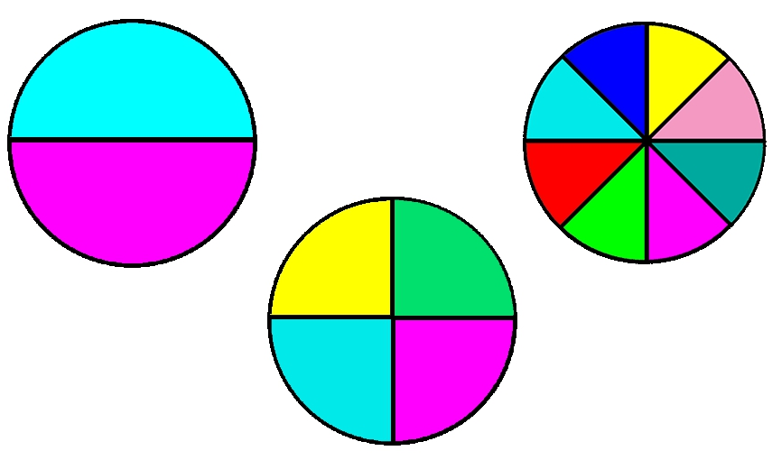


ABC
C
T
I
O
N

Slide 3

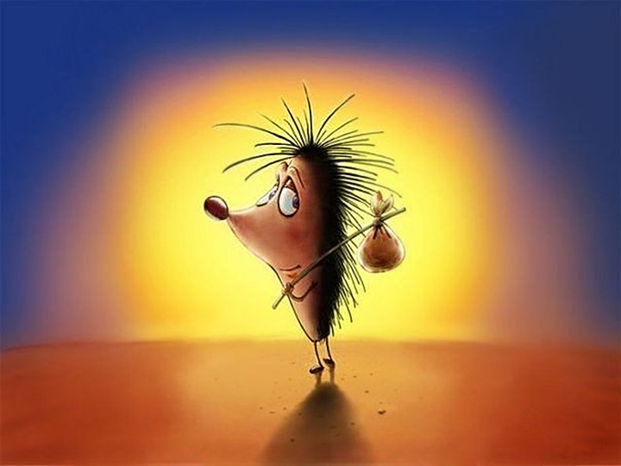
ABC
E
A
R
Breath properly!
Believe me, everything will pass.
Even if it's very bad, it will end someday.
Nothing lasts forever.

Slide 4
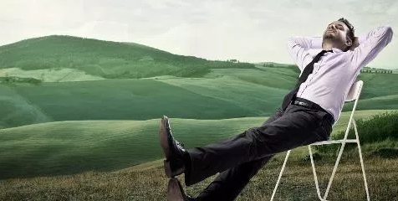

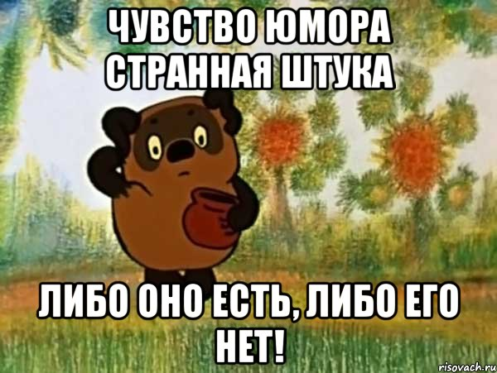
ABC
O
P
E
A sense of humor is
a strange thing.
It exists or it doesn't.

