Slide 1
Phrasal verbs “to take”
Form 10
Module 2

Slide 2
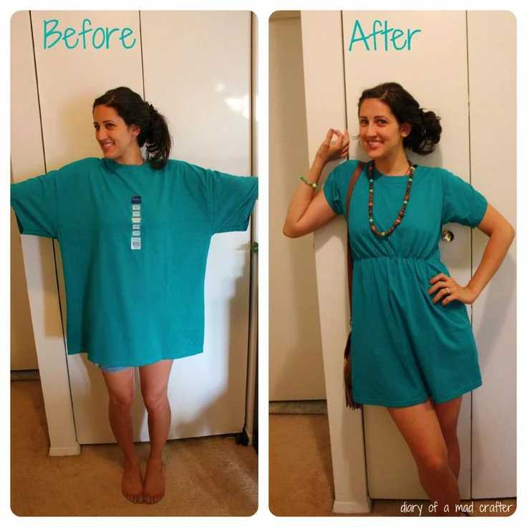
To take in

Slide 3
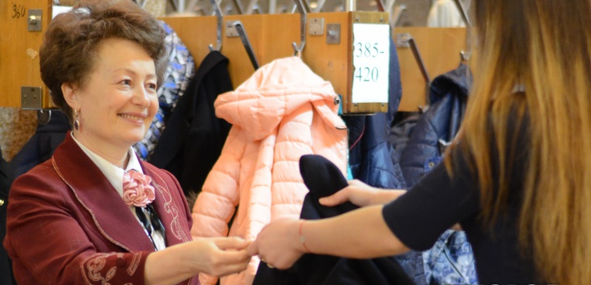
To take off (cloakroom)

Slide 4

To take out

Slide 5

To take after

Slide 6

To take up

Slide 7

To take over

