Slide 1
Form 10
Module 5
Listening and speaking skills

Slide 2
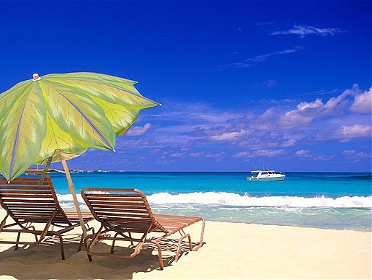
Types of holiday
Self-catering
Full board
Half-board
Cruise
Beach
Backpacking
Skiing
Camping
Rest at home

Slide 3
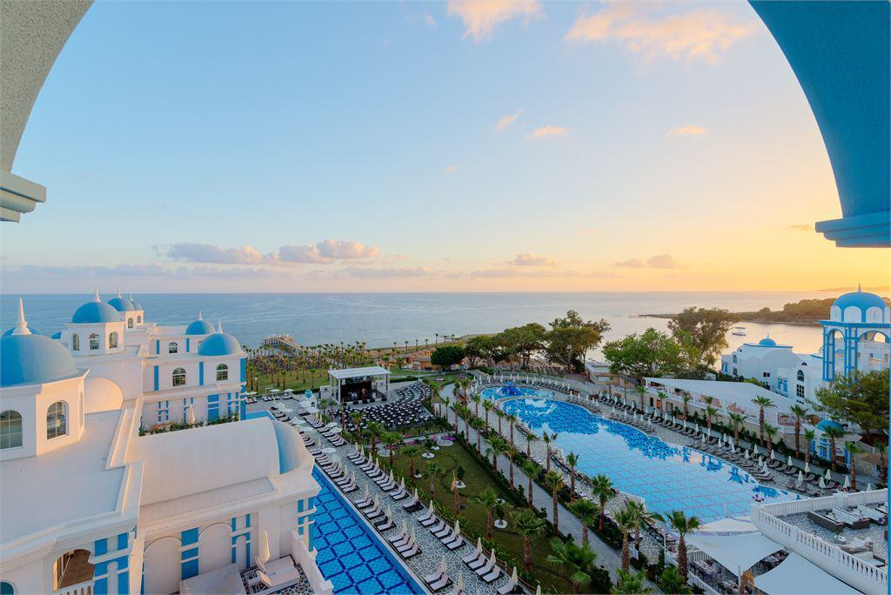
Places to stay
Hostel
Hotel
Apartment
Campsite
As a guest (at relatives)

Slide 4
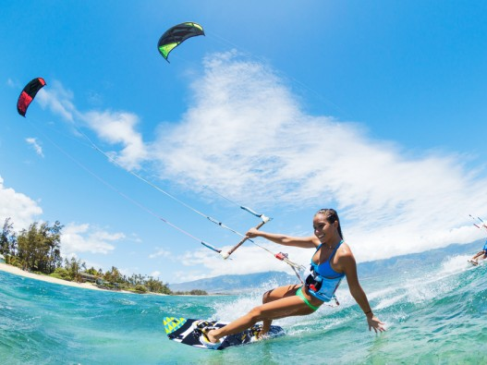
Activities
Go on a guided tour
Swimming
Hiking
Souvenir shopping
Sightseeing
Go to the (cinema, theatre, museum)

Slide 5
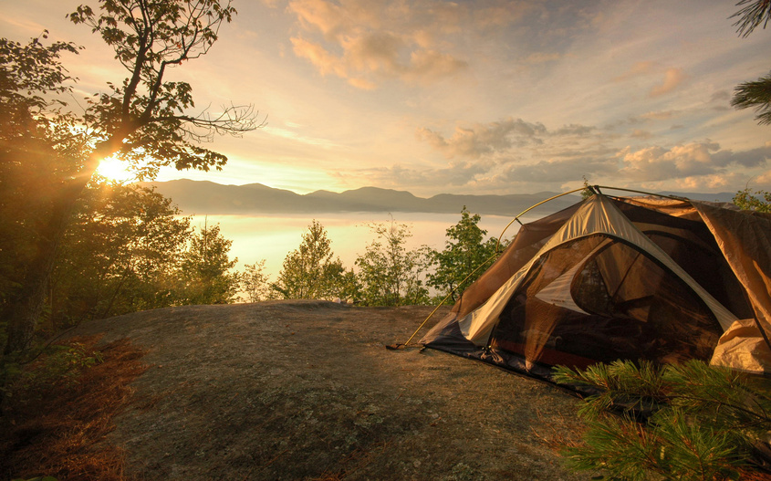
Weather
Boiling hot
Sunny
Freezing cold
Windy
Calm
Rainy
Wonderful
Awful

