Slide 1
Past Tenses
Прошедшие времена

Slide 2
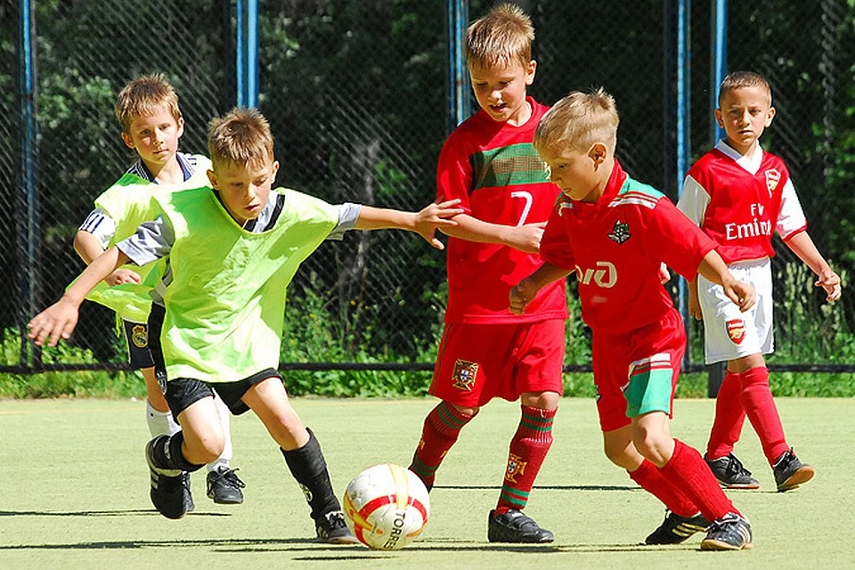
Past Simple
(did) V2
We played football yesterday.
Did you play football yesterday?
He did not play football yesterday.
Обозначает:
факт, законченное действие в прошлом;
события, происходящие в прошлом
одно за другим;
- привычки и повторяющиеся действия в прошлом.

Slide 3

Past Perfect
have V3
We had written a test.
Had you written a test?
He had not written a test.
Обозначает:
действие, которое предшествовало другому в
прошлом;
причину того, что произошло в прошлом.

Slide 4
Use Past Simple or Past Perfect:
A: … you (manage) to catch the 8 o’clock train last
night?
B: No, it … already … (leave) when I … (get)
there.
2. A: What … Helen (do) when she … (arrive) home?
B: Well, she … (make) something to eat and then
she … (go) to bed.
3. A: … the children (see) their father yesterday?
B: No. by the time he … (drive) back from the city,
they … already (fall) asleep.

Slide 5
Сheck:
A: Did you manage to catch the 8 o’clock train last
night?
B: No, it had already left when I got there.
А: Ты успел на 8-часовой поезд вчера?
Б: Нет, он уже ушел, когда я туда приехал.
2. A: What did Helen do when she arrived home?
B: Well, she had made something to eat and then
she went to bed.
А: Что Хелен делала, когда приехала домой?
Б: Сначала она приготовила поесть, а потом легла спать.
3. A: Did the children see their father yesterday?
B: No. by the time he drove back from the city,
they had already fallen asleep.
А: Дети видели папу вчера?
Б: Нет. К тому времени как он приехал из города, они уже заснули.

Slide 6
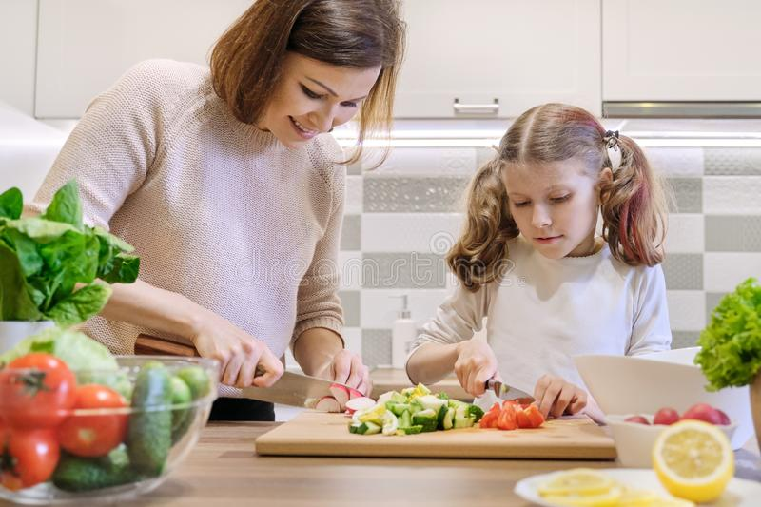
Past Continuous
Was/were Ving
We were cooking dinner.
Were you cooking dinner?
He was not cooking dinner.
Обозначает:
действие, которое длилось в определенный момент
в прошлом;
два действия в прошлом, длившихся одновременно.

Slide 7
Use Past Simple or Past Continuous:
I … (take) a bath when the phone (ring).
2. Last evening at 8 p.m. we … (watch) TV.
3. Yesterday while our mum … (cook) dinner, we …
(clean) the room.
4. I … (think) of you, when you … (come) in.
5. … you … (do) your homework when I … (call)
Yesterday?

Slide 8
Check:
I was taking a bath when the phone rang.
Я принимал ванну, когда зазвонил телефон.
2. Last evening at 8 p.m. we were watching TV.
Вчера вечером в 8 часов мы смотрели ТВ.
3. Yesterday while our mum was cooking dinner, we
were cleaning the room.
Вчера в то время как мама готовила ужин, мы убирали комнату.
4. I was thinking of you, when you came in.
Я думал о тебе, когда ты пришла.
5. Were you doing your homework when I called
yesterday?
Ты делал домашнюю работу, когда я позвонил вчера?

Slide 9

Past Perfect Continuous
Had been Ving
We had been working at the project.
Had you been working at the project?
He had not been working at the project.
Обозначает:
действие, которое началось в прошлом, длилось
какое-то время и закончилось к моменту речи о нем
или все еще продолжалось в прошлом.

Slide 10
Use Past Perfect Continuous or Past Perfect:
A: John was really tired yesterday.
B: Sure he was. He … (work) in the garden all day.
2. A: Did you meet Jerry?
B: No. by the time I arrived, he … (leave).
3. A: Pat was really mad at me.
B: I bet she was. She … (wait) for two hours
before you called.

Slide 11
Check:
A: John was really tired yesterday.
B: Sure he was. He had been working in the garden
all day.
А: Джон действительно устал вчера.
Б: Конечно. Он работал в саду весь день.
2. A: Did you meet Jerry?
B: No. Вy the time I arrived, he had left.
А: Ты встретился с Джерри?
Б: Нет. К тому времени как я пришел, он уехал.
3. A: Pat was really mad at me.
B: I bet she was. She had been waiting for two
hours before you called.
А: Пэт была реально зла на меня.
Б: Держу пари, что да. Она ждала два часа,
прежде чем ты позвонил.

