Slide 1
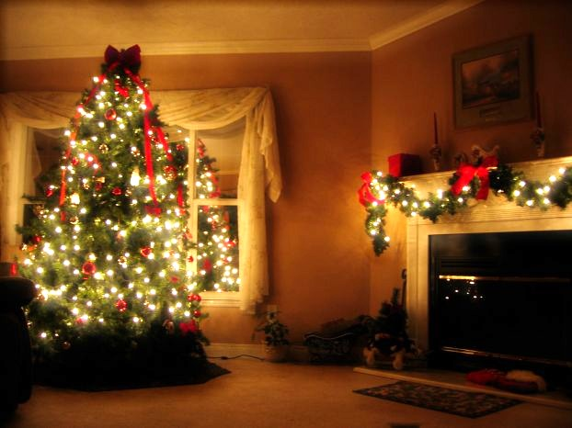
1 January – New Year’s Day

Slide 2
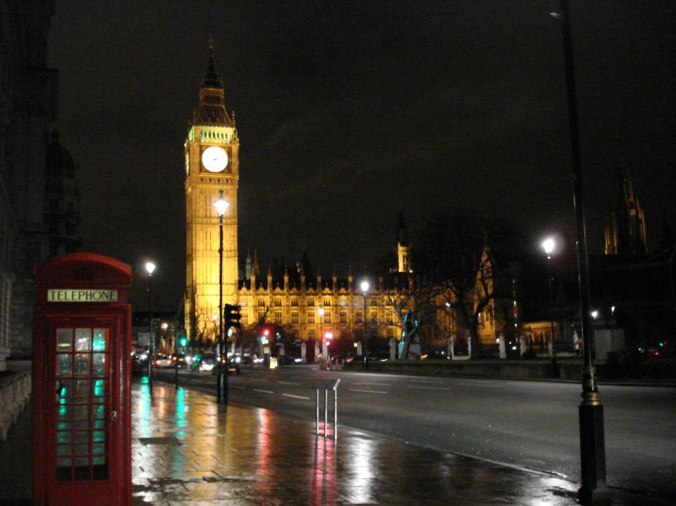
Big Ben is striking 12.

Slide 3
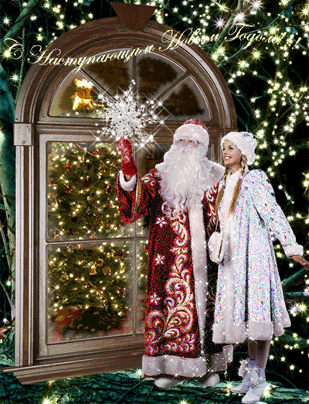
People wish each other “Happy New Year”

Slide 4
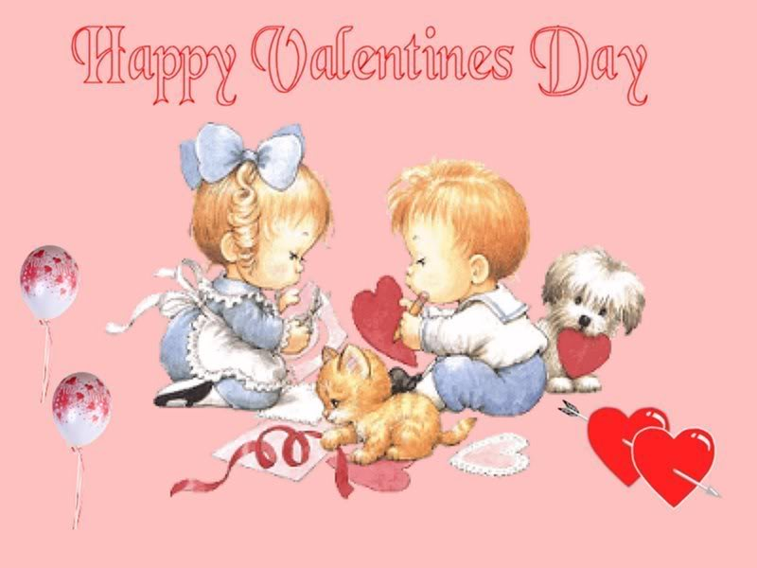
14 February – St Valentine’s Day

Slide 5
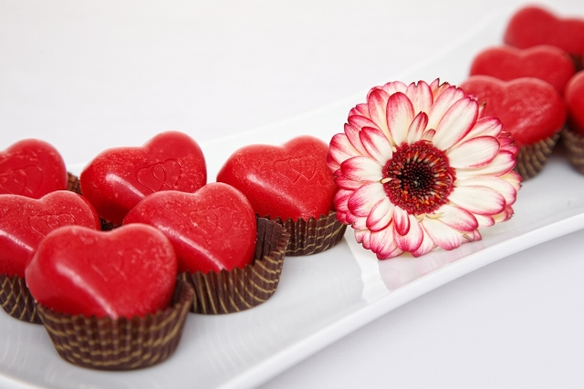
Presents for sweethearts

Slide 6

Red rose is a symbol of love.

Slide 7
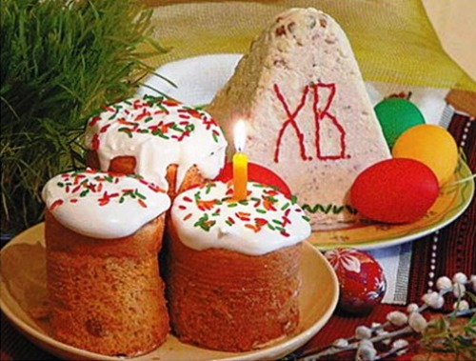
Easter Festival

Slide 8
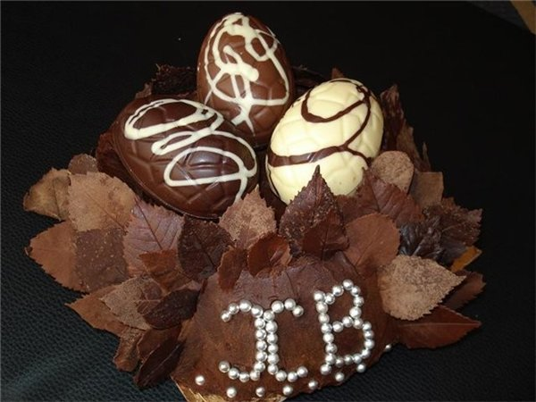
Children get chocolate eggs.

Slide 9
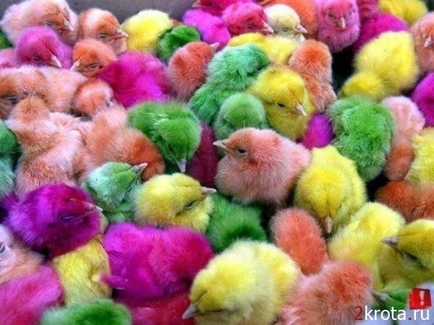
Easter means new life.

Slide 10
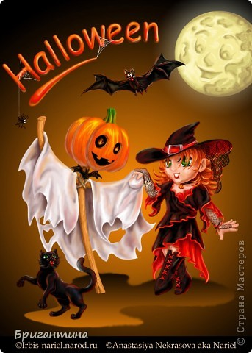
31 October - Halloween

Slide 11
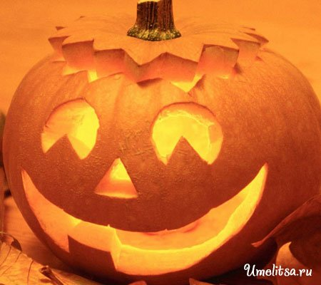
Halloween’s lamp of pumpkin

Slide 12
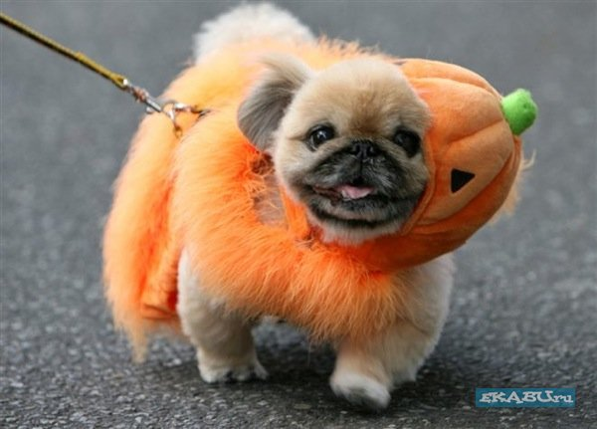
People and even animals dress up for Halloween parties.

Slide 13
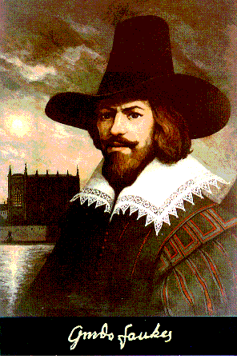
5 November – Guy Fawkes’ Night

Slide 14
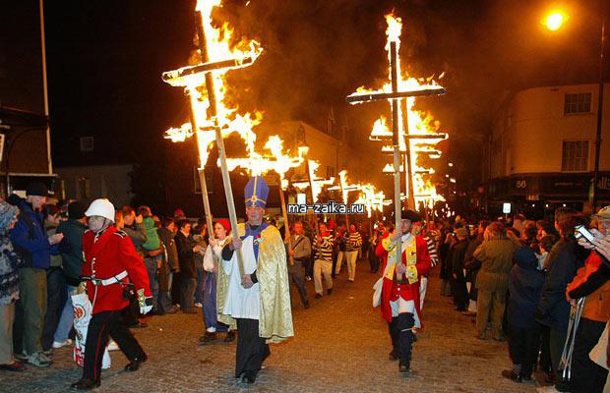
Guy Fawkes’ Night

Slide 15
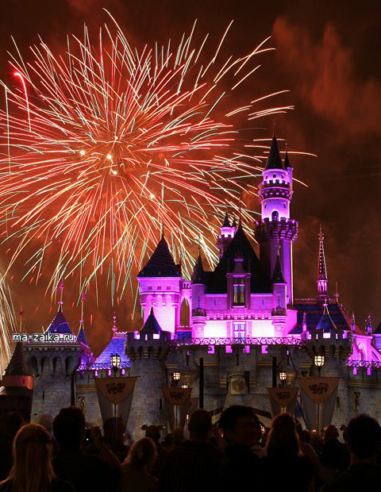
Big firework

Slide 16
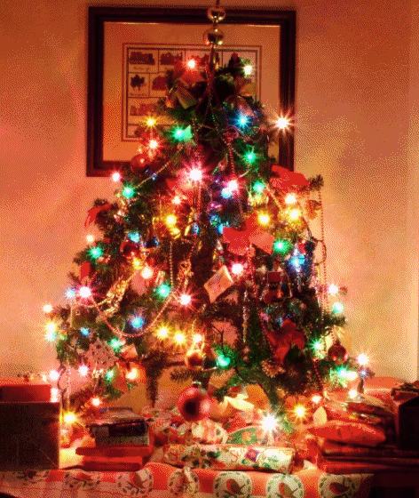
25 December – Christmas Festival

Slide 17
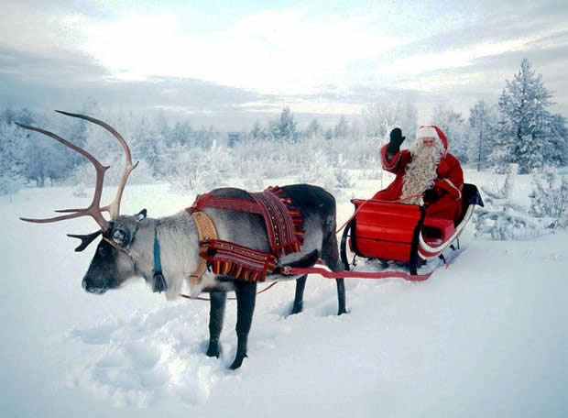
Father Christmas

Slide 18
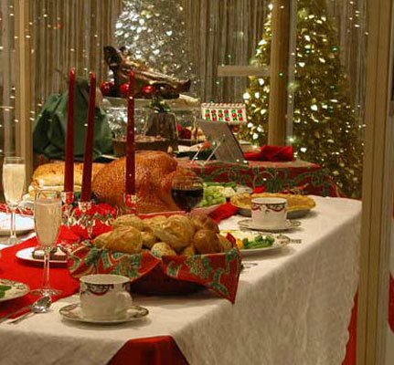
Big dinner

Slide 19
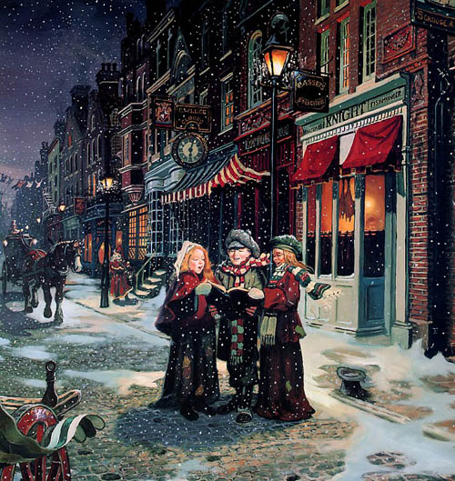
Carolers sing Christmas songs on Christmas Day.

Slide 20
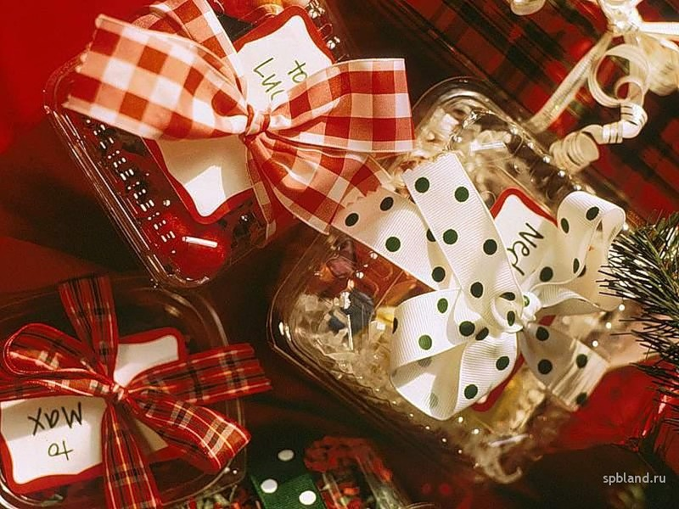
Boxing Day

Slide 21
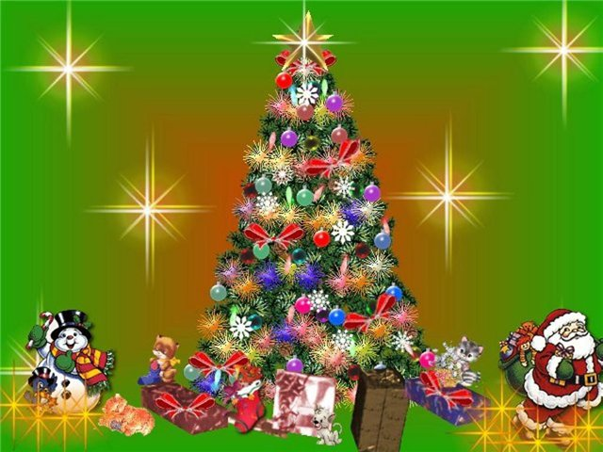
Happy Christmas!!!

Slide 22
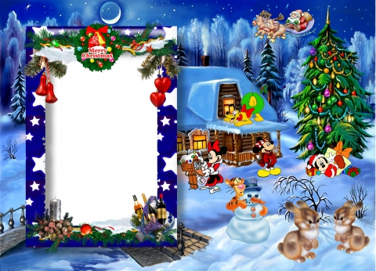
Wishes
Merry Christmas, dear boys and girls!!!
Good luck!!!
Good marks!!!
Be healthy, wealthy and wise!!!

