Slide 1
Speaking about famous people
Form 7

Slide 2
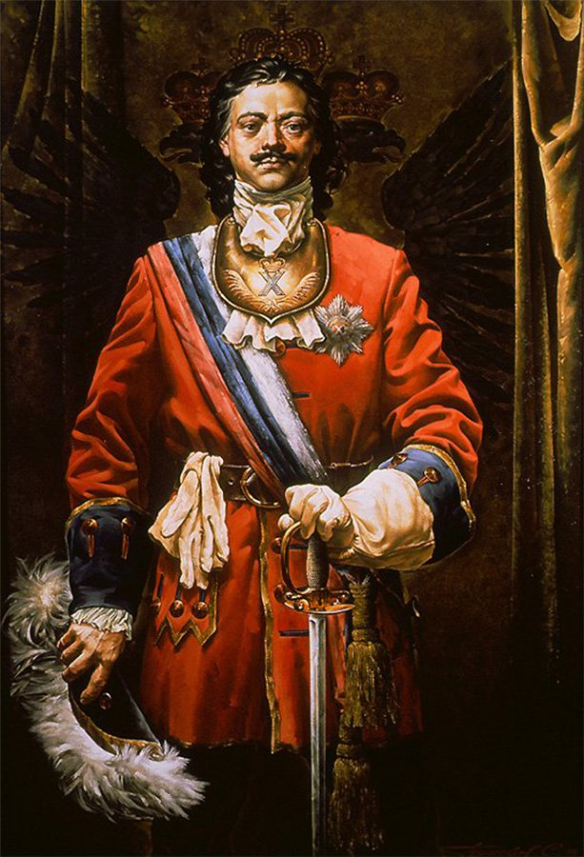
Peter I
30. 05. 1672 –
28. 01. 1725
Russia

Slide 3
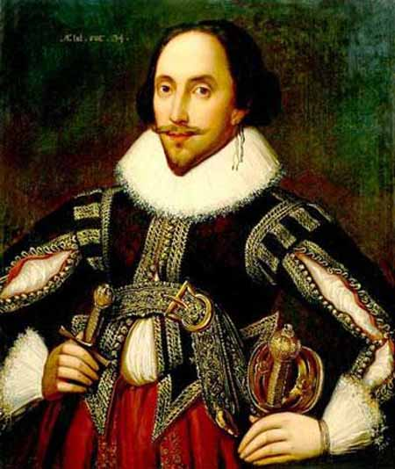
William
Shakespeare
26. 04. 1564 –
23. 04. 1616
Britain

Slide 4
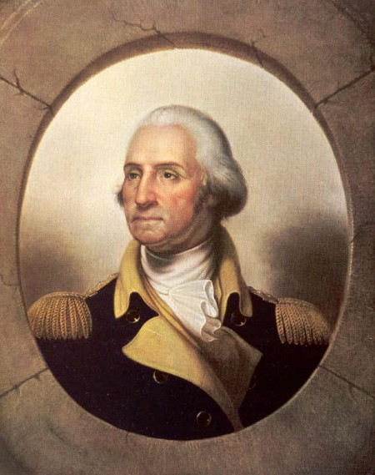
George
Washington
22. 02. 1732 –
14. 12. 1799
The USA

Slide 5
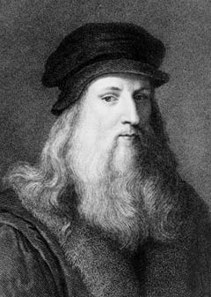
Leonardo
Da Vinci
15. 04. 1452 –
02. 05. 1519
Italy

Slide 6
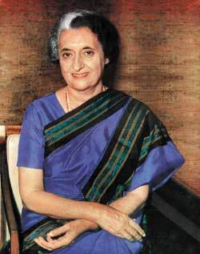
Indira Gandi
19. 11. 1917 –
31. 10. 1984
India

Slide 7
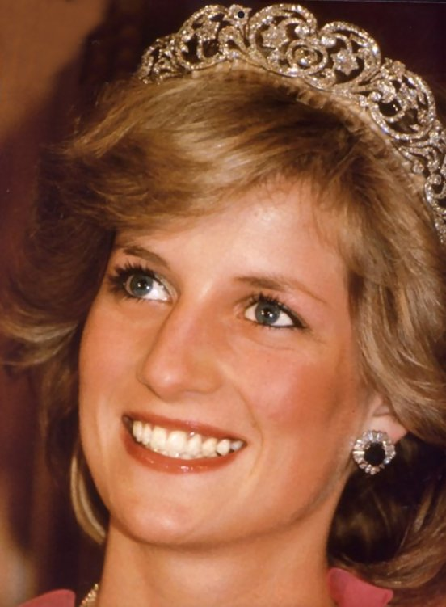
Princess Diana
01. 07. 1961 –
31. 08. 1997
Britain

