Slide 1
Stonehenge
Form 6

Slide 2
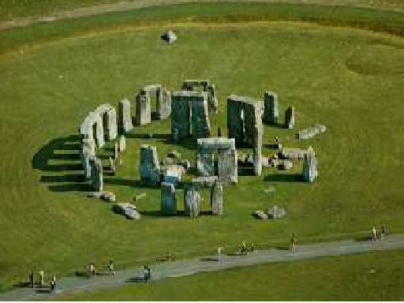
Stonehenge is
one of Europe’s biggest stone circles.

Slide 3
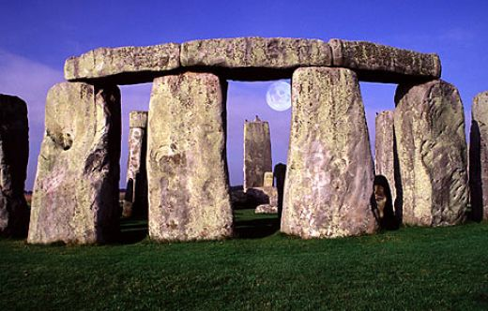
The height of some stones is
about ten or twelve metres.

Slide 4
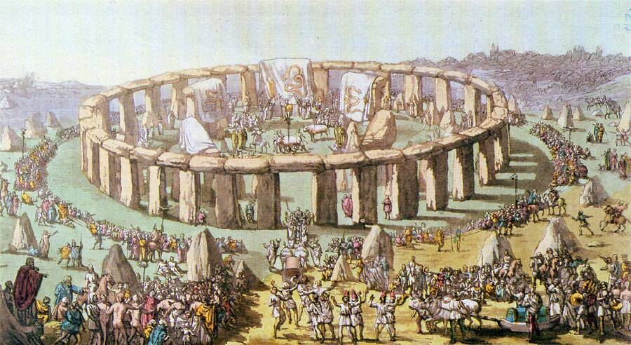
Scientists think that the oldest part
of Stonehenge is 5’000 years old.

Slide 5
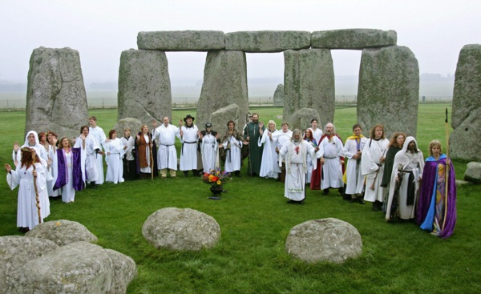
Some people think that the Druids
built Stonehenge.

Slide 6
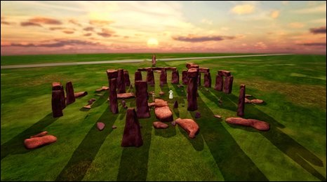
Some people think that Stonehenge
was used as a calendar. Others think
that people used Stonehenge for religious
ceremonies.

Slide 7
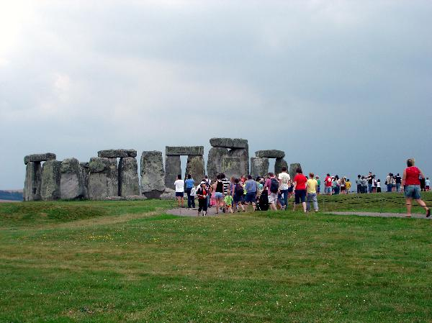
Now Stonehenge is a tourist attraction.

