Slide 1
Form 6
Module 1
Appearance

Slide 2
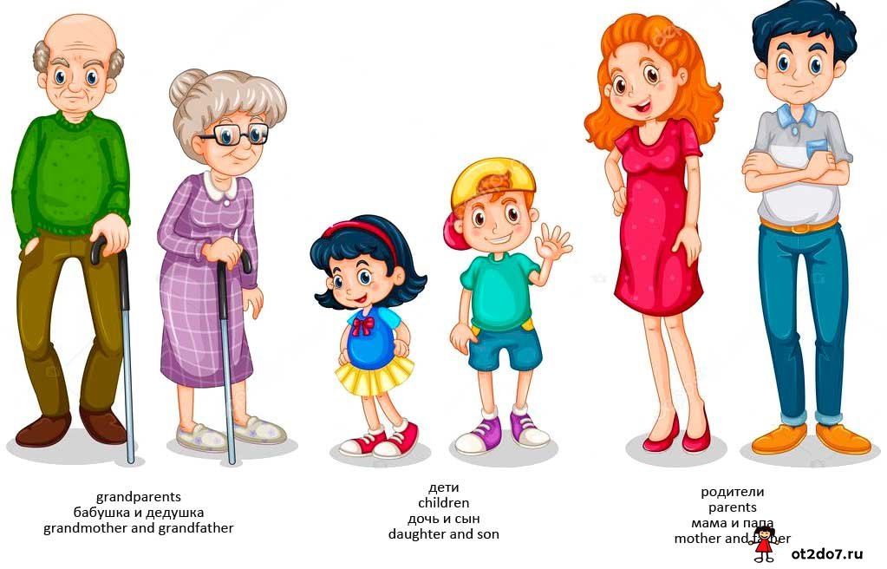

Slide 3
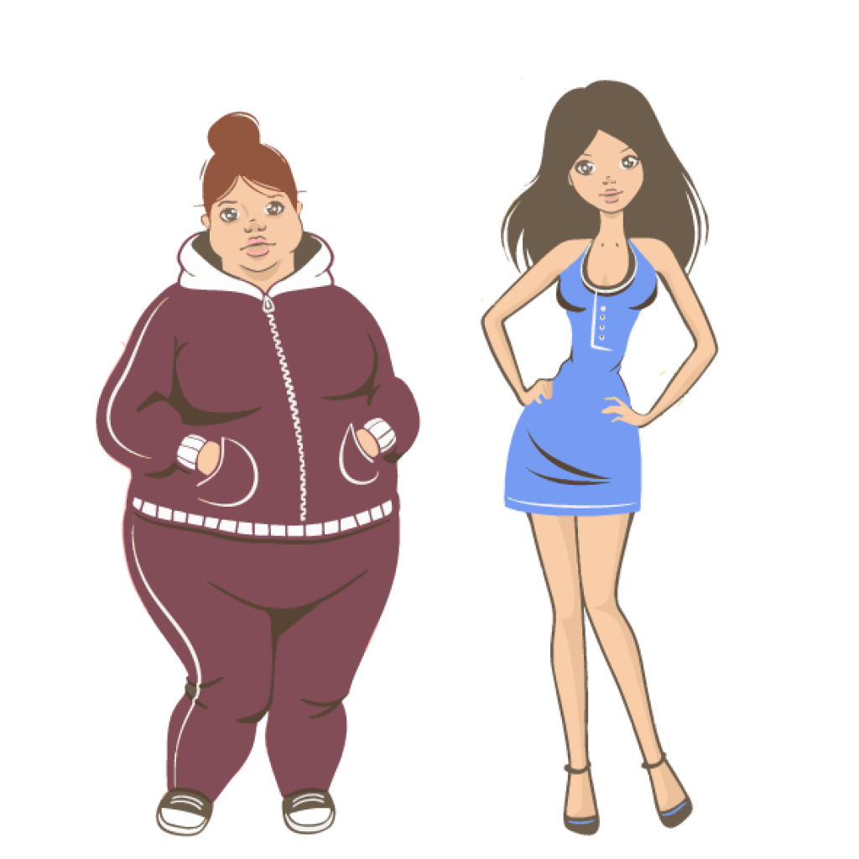

Slide 4

