Slide 1
London transport
Form 6 Module 3

Slide 2
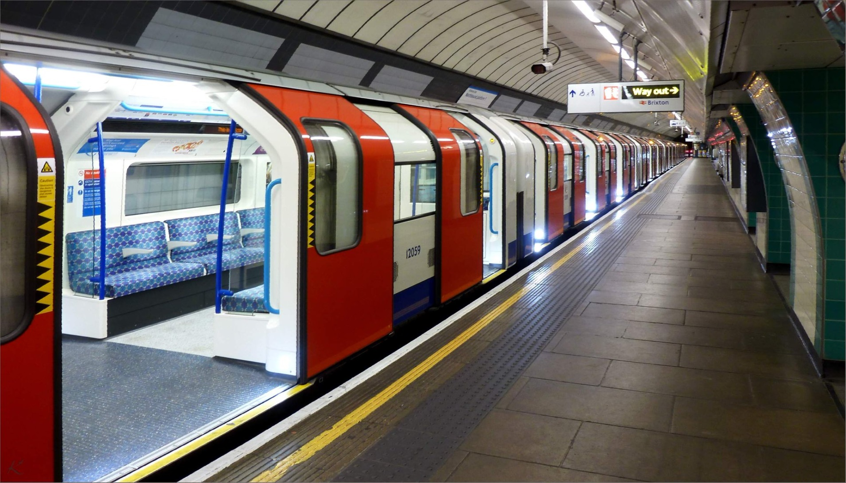
Tube

Slide 3
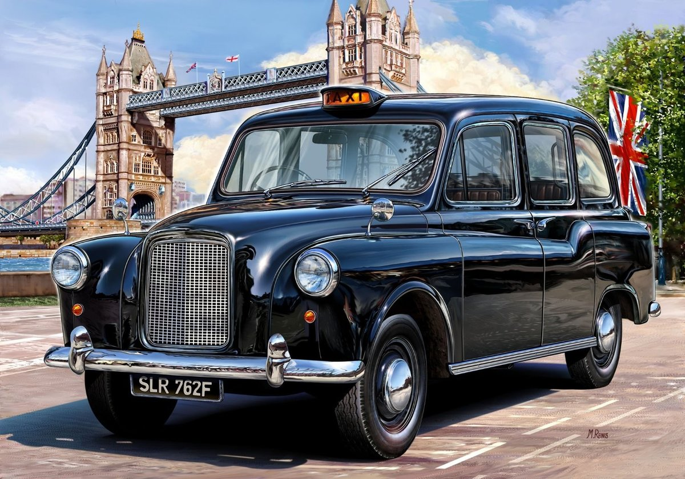
Black cab

Slide 4
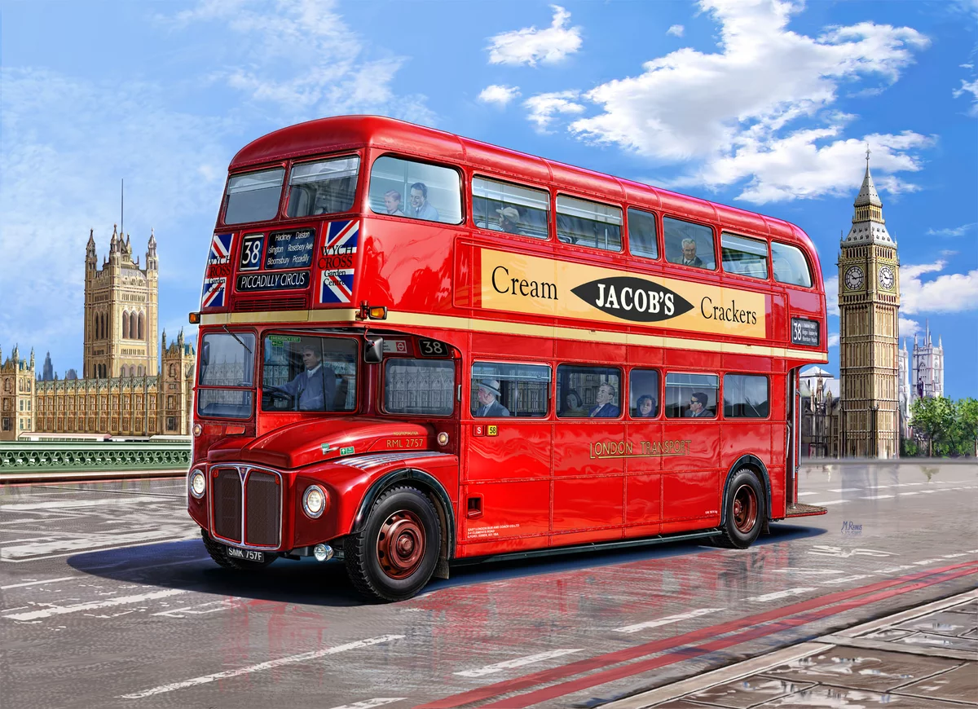
Red double-decker bus

