Slide 1
Form 5 Module 1
To be
Personal pronouns

Slide 2
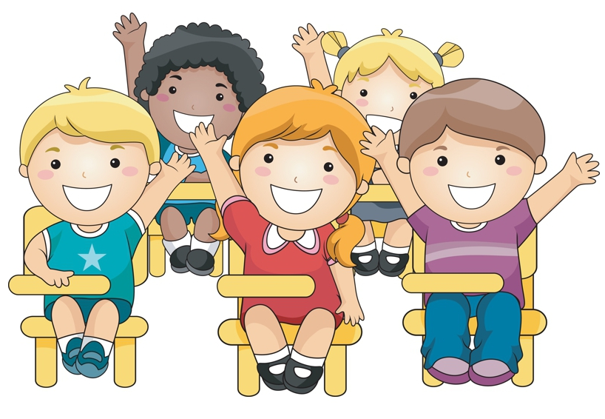
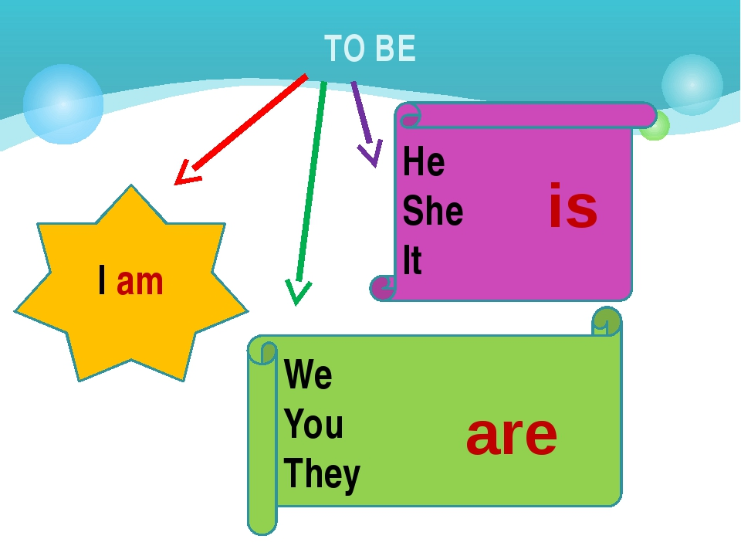
The children … in Room D.
are

Slide 3
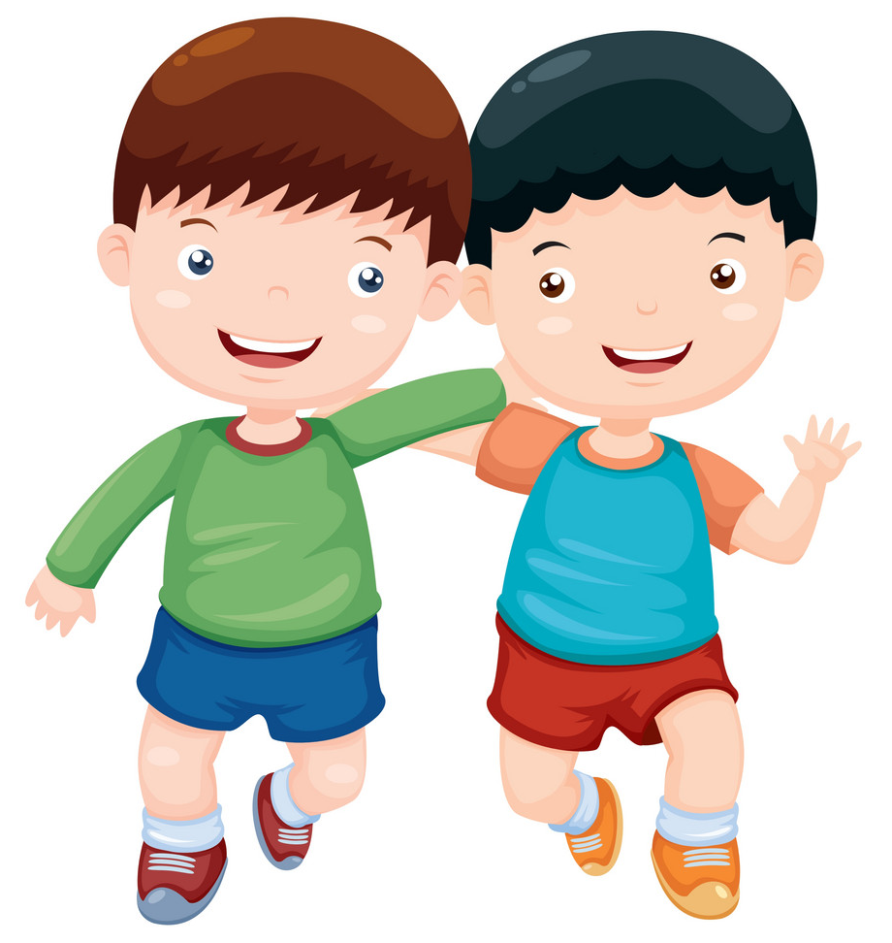
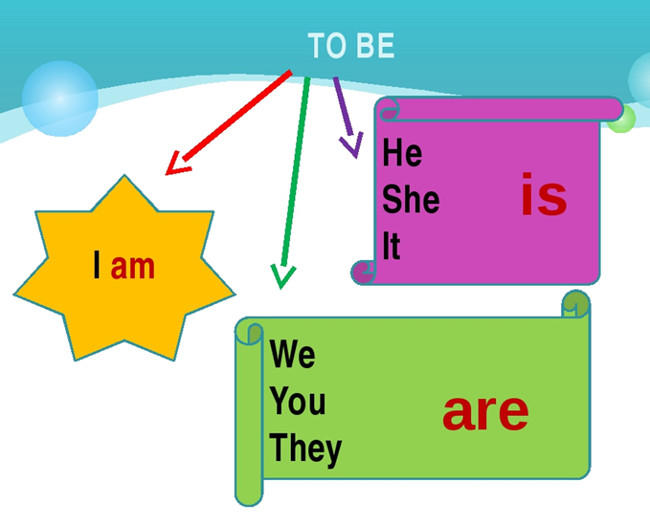
Ben … my best friend.
is

Slide 4
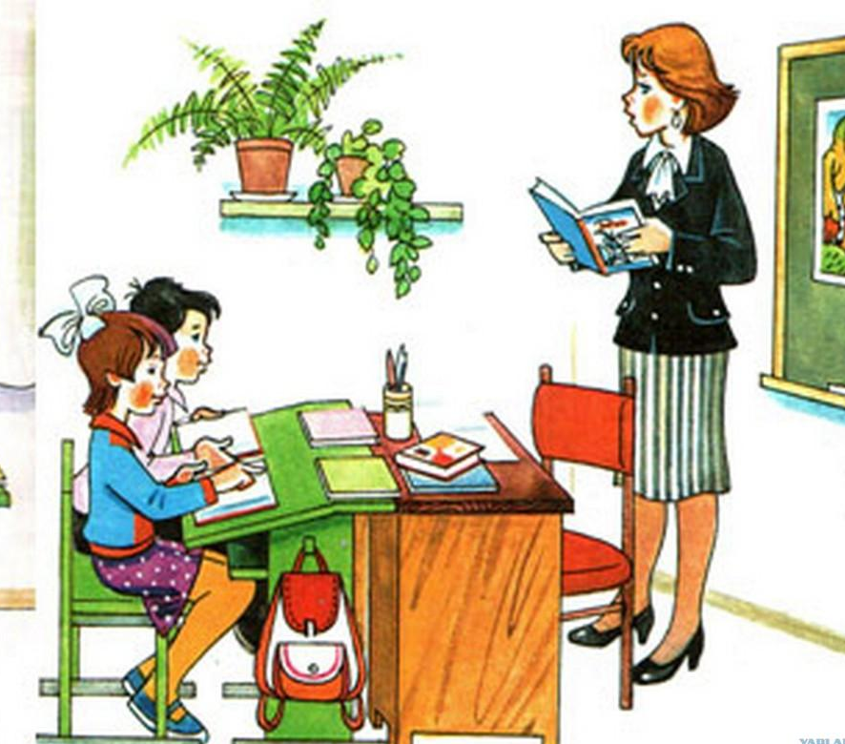
are
Tom and I … in Class 4.

Slide 5
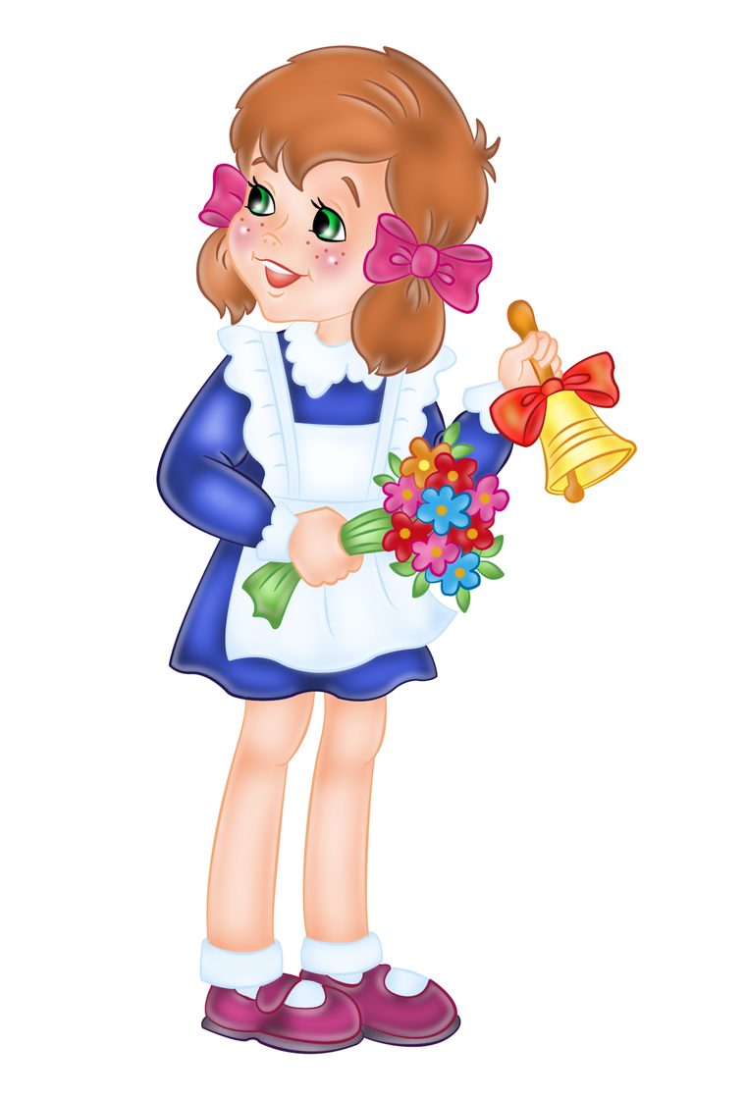
Linda … seven years old.
is

Slide 6

am
I … Jack.

