Slide 1
Form 5 Module 2
Quiz “Countries and their capitals”

Slide 2
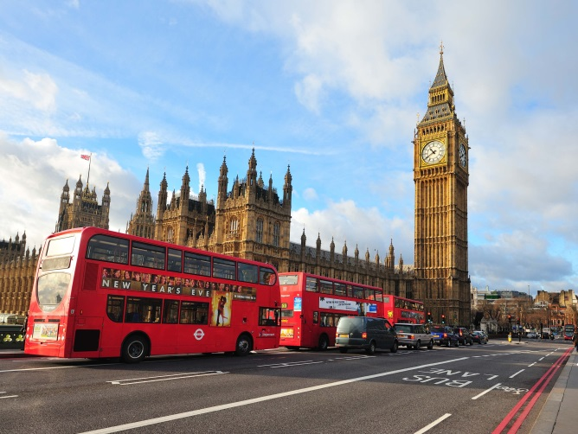
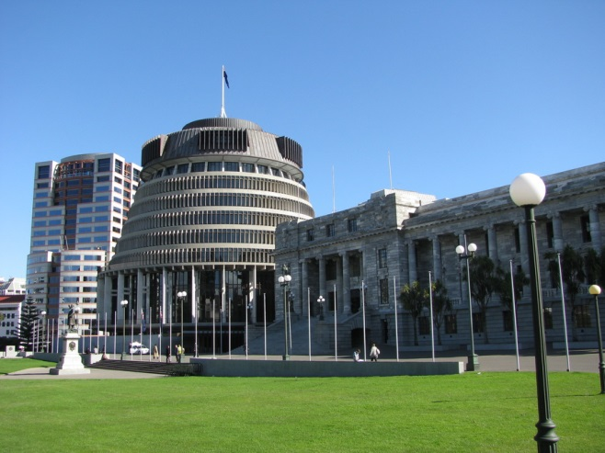
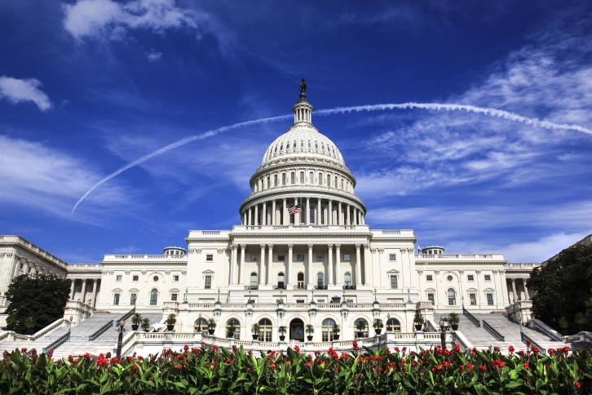
What is the capital of the UK?
London
Wellington
Washington

Slide 3

What is the capital of the USA?
Canberra
Wellington
Washington

Slide 4


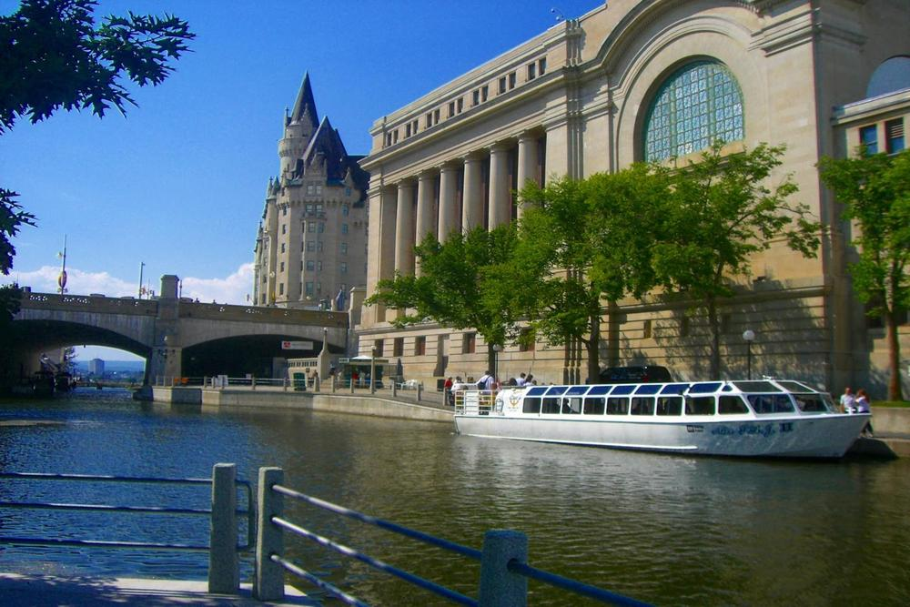
What is the capital of Australia?
Canberra
London
Ottawa

Slide 5
What is the capital of Canada?
London
Wellington
Ottawa

Slide 6
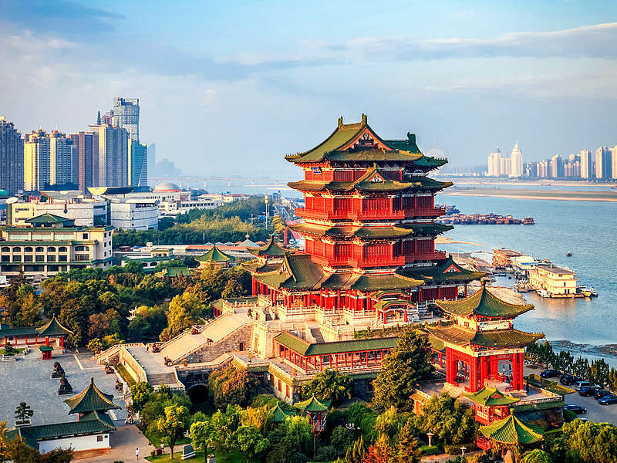
What is the capital of China?
London
Beijing
Ottawa

