Slide 1
Урок английского языка
5 класс
Тема урока:
«Климат Аляски. Погода. Выбор одежды»

Slide 2
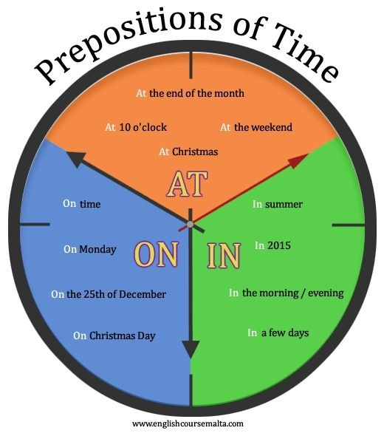

Slide 3
prepositions of time
___ Monday
___ summer
___ 2021
___ the morning
___ the 9 o’clock
___ Christmas day
___ Christmas

Slide 4
Check yourself:
on Monday
in summer
in 2023
in the morning
at the 9 o’clock
on Christmas day
at Christmas

Slide 5
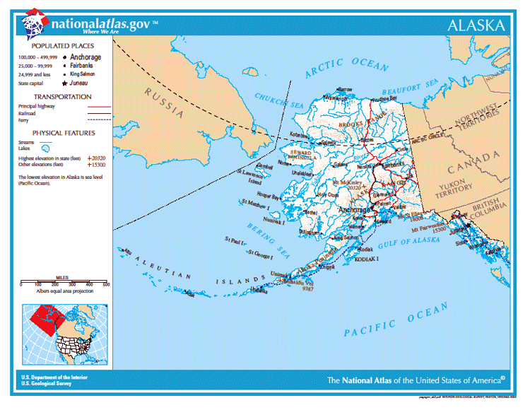
АLASKA
Alaska is situated in the northwest of America.

Slide 6
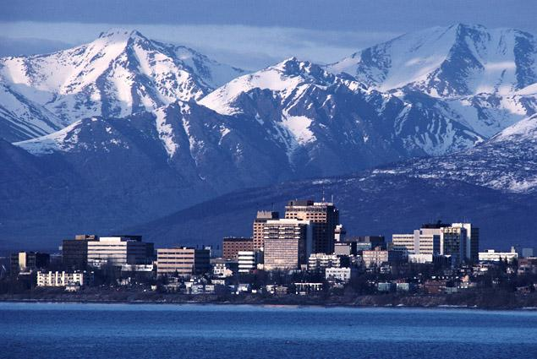
Winters are cold with lots of snow. The average winter temperature in January varies from -12 ° C to -5 ° C. Winds are strong.

Slide 7
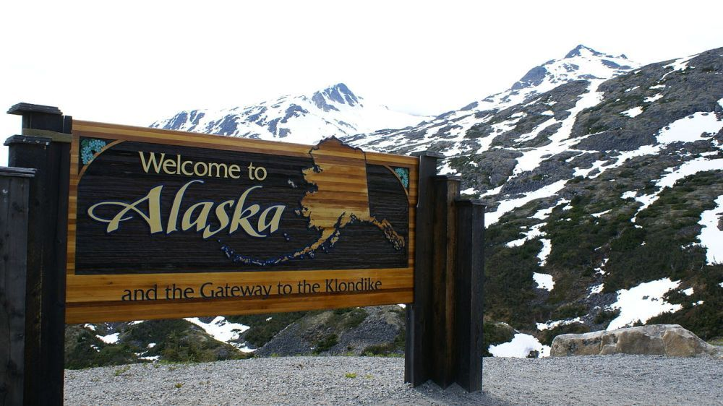
Summers are cool with lots of rain. The average temperature in July varies from 10 ° C to 18 ° C (sometimes 27 ° C ). Light wind blows in summer.

Slide 8
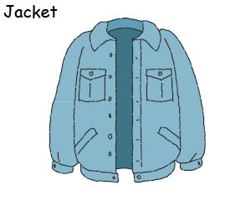
Сlothes

Slide 9
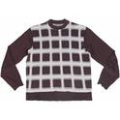
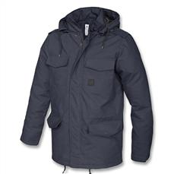
Winter coat Sweater

Slide 10

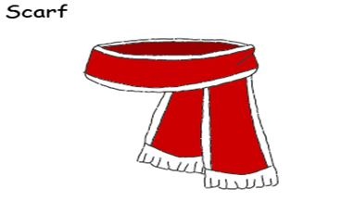
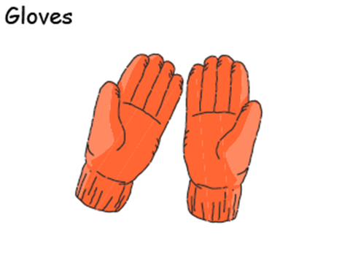
Warm hat
Scarf
Gloves

Slide 11
P1: Is it cold in winter in Alaska?
P2: Oh , yes. It`s very cold.
P1: What clothes do I need?
P2: You need …
P1: Do I need a T-shirt?
P2: No, you don`t.
P1: Thank you.

