Slide 1
Phrasal verb “to check”
Module 8
Form 11

Slide 2

What time do we have to check … of the hotel?
out

Slide 3
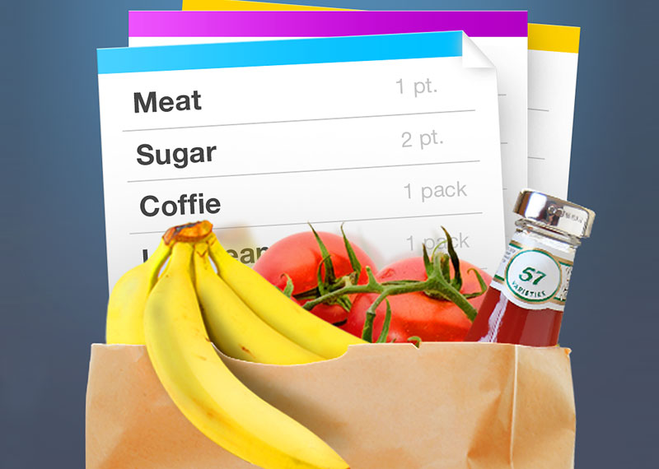

I’ve checked … everything on the list so we can finish shopping now.
off

Slide 4
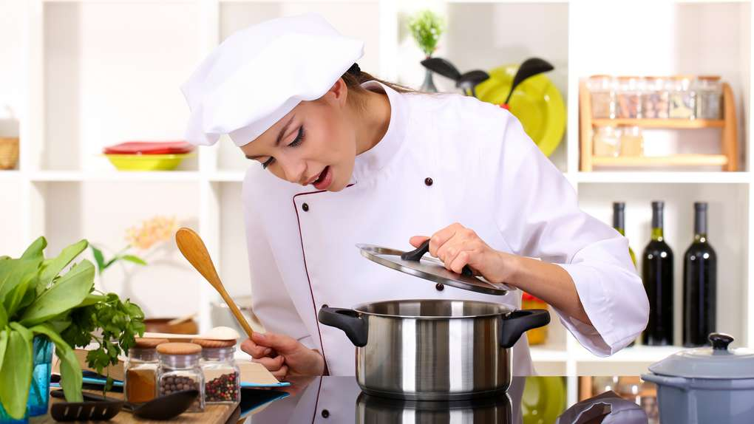
Can you check … the dinner and make sure it’s not burning?
on

Slide 5
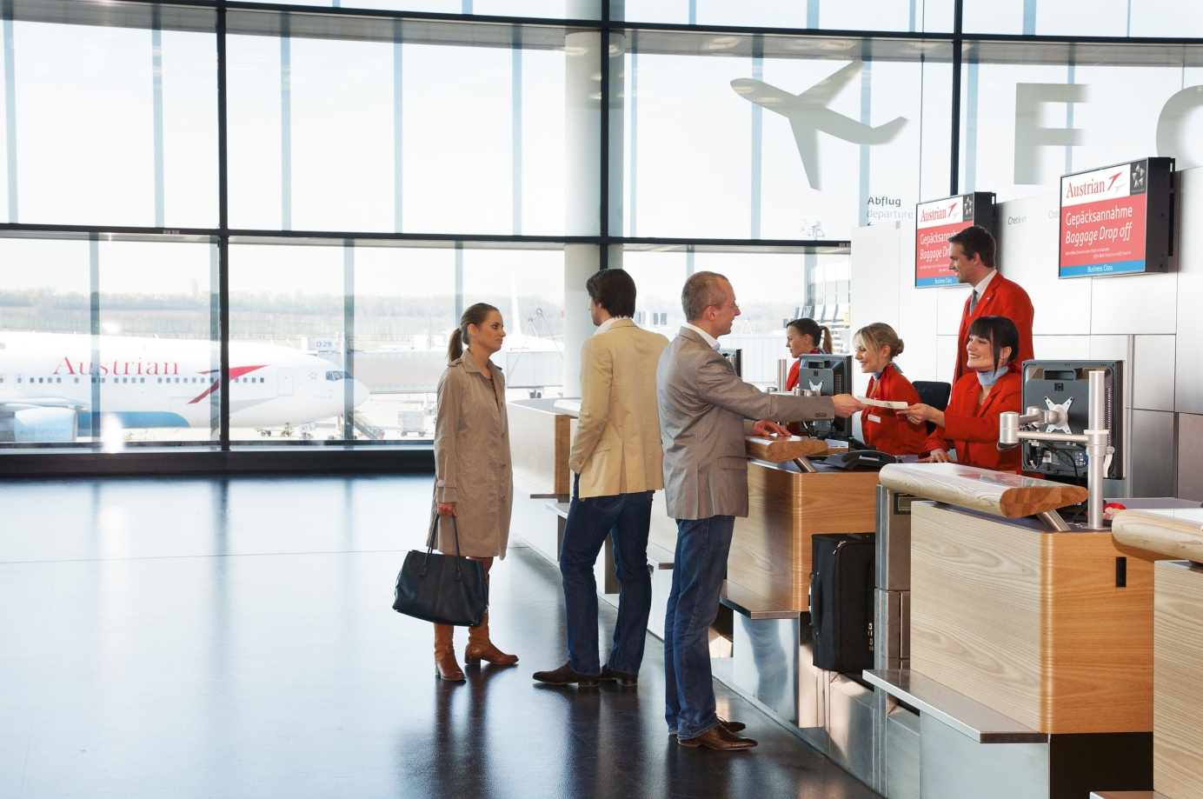
Sam checked … and went to wait in the departure lounge.
in

Slide 6
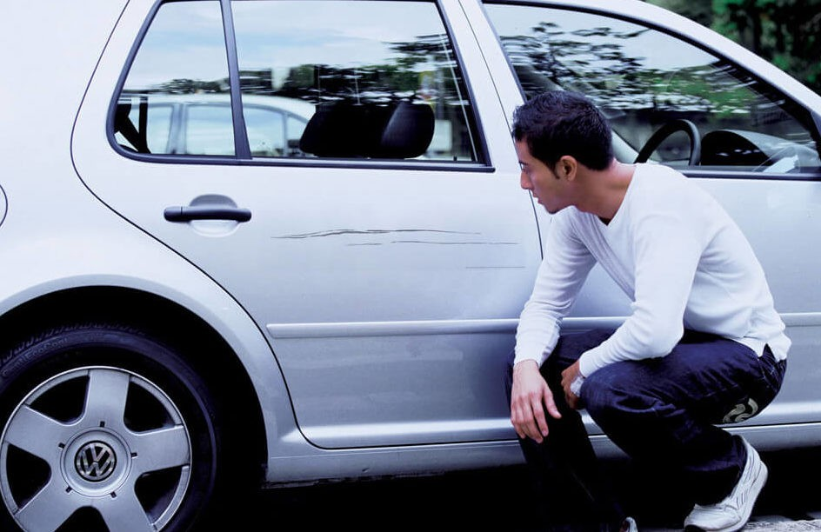
The driver checked … the damage before getting back into his car.
over

